Slide 1
Tower Bridge
А magnificent architectural creation

Slide 2
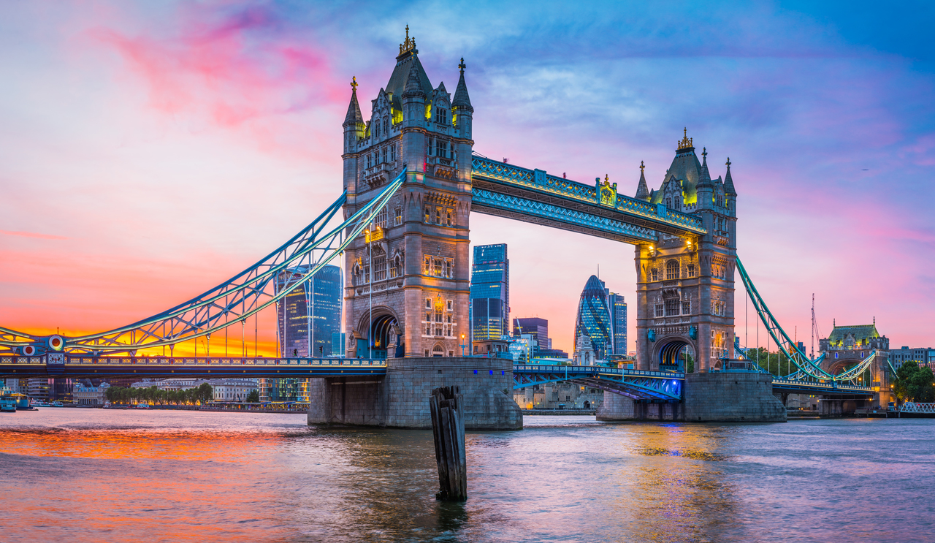
Location
Tower Bridge is located in London, spanning the River Thames between the districts of Tower Hamlets and Southwark.

Slide 3
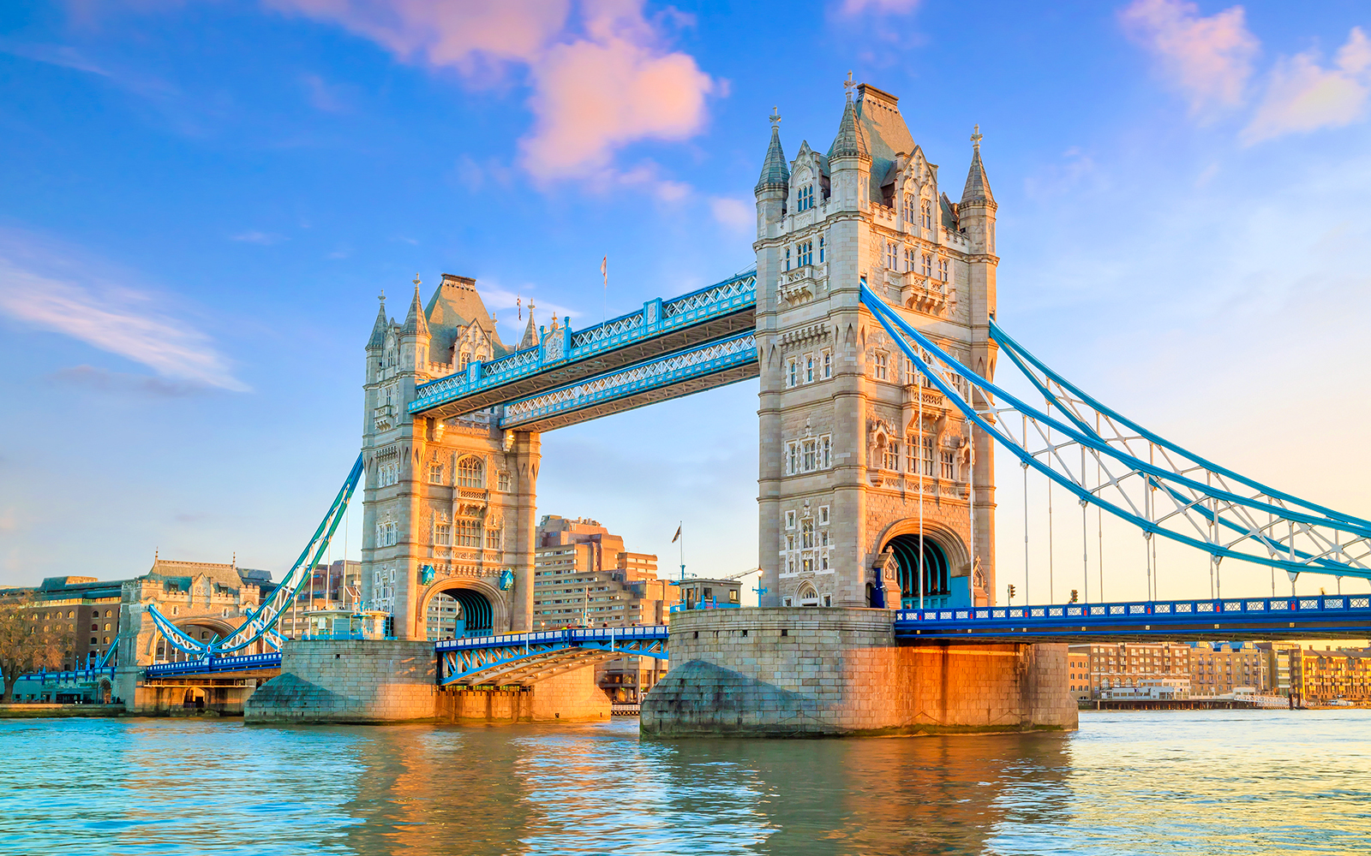
The history
It was built at the end of the XIX century and opened for use in 1894. It was a time of rapid growth of London as a world trade and industrial center, and the creation of the bridge was a necessary step to facilitate traffic across the River Thames. The design of the bridge was chosen as a result of a competition, and the submitted solution was supported by Queen Victoria.

Slide 4
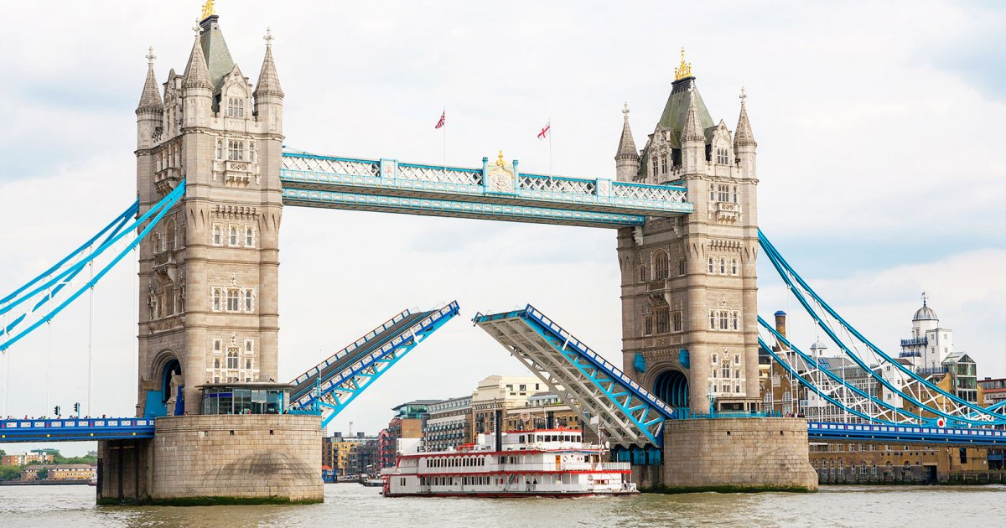
Lifting mechanism
Tower Bridge, features a unique lifting mechanism following its central span to be raised to accommodate passing ships on the River Thames. When a vessel needs to pass through, the bascules (counterweighted sections) are raised by means of a hydraulic system. This lifting process is carefully controlled to ensure the safe passage of ships beneath.

Slide 5
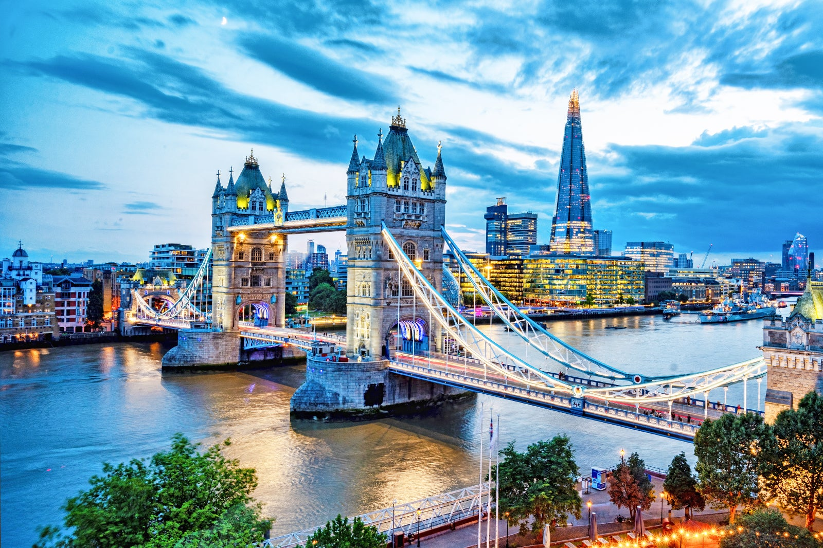
Architecture
The design of Tower Bridge reflects the Victorian fascination with Gothic architecture, evident in the pointed arches, decorative turrets, and elaborate carvings adorning the towers and walkways. Is primarily constructed of steel and masonry, with intricate detailing in wrought iron and bronze. The use of durable materials ensures the structural integrity of the bridge while also contributing to its aesthetic appeal.
Overall, Tower Bridge is a masterpiece of architectural design, blending form and function in a harmonious union that has captivated visitors and locals alike for generations.

Slide 6
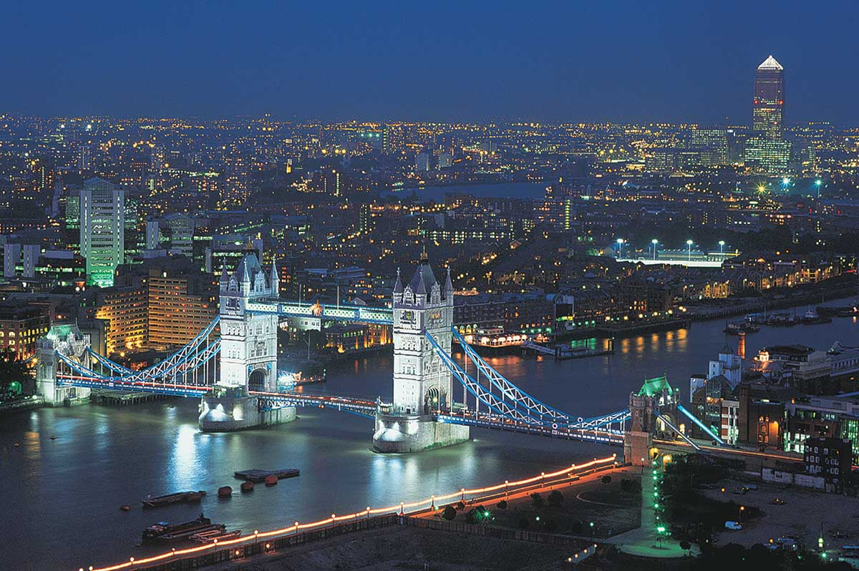
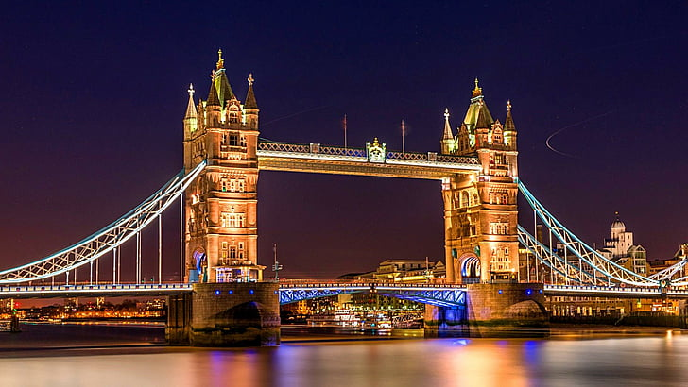
Mesmerizing night illumination
Tower Bridge is decorated with illumination, turning it into a landmark of the London skyline. Equipped with a modern LED lighting system, the bridge is able to demonstrate a rich variety of colors and patterns, adding dynamism to its architectural beauty. Bright shows often coincide with special events, enhancing the festive atmosphere of the city. Illuminated by LED lights, the towers of Tower Bridge and metal structures are highlighted, casting dramatic highlights on the surface of the River Thames below.

Slide 7

Thanks for attention)
Prepared: Sidorov D. S.

